Slide 1
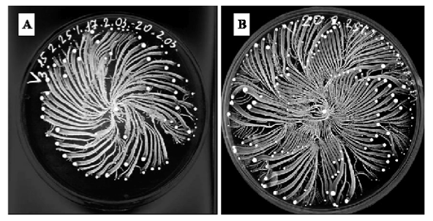
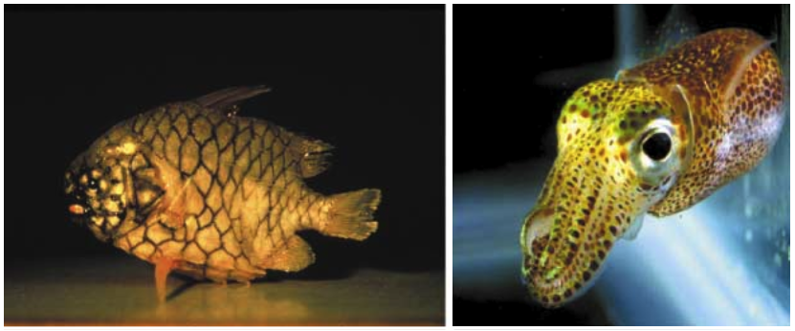
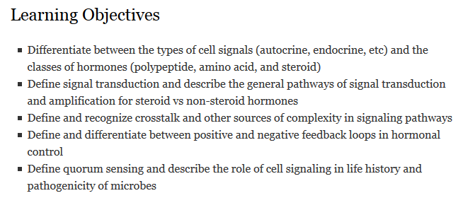
Module 3: Chemical and Electrical Signals
Hormones and chemical signals
Neurons and integration
Sensory systems
Effectors
L: Ben-Jacob. 2008. Eur Phys J B, 65: 315-322
R: Fuqua & Greenberg. 2002. Nature Rev Mol Cell Biol, 3: 685-695
Notes:
Right: An Australian pinecone fish (12 cm long). The red organ on the lower jaw is a light organ that contains 10¹⁰V. fischeri cells per ml fluid. The light organ appears red in this photograph because the light-organ tissue is highly vascularized. Australian pinecone fish are nocturnal reef dwellers and they use the light organ to search for prey at night. c | A Hawaiian bobtail squid. This adult squid is 2 cm long. There is a V. fischeri light organ close to the ink sac within the mantle cavity of the animal. This light organ contains 10¹¹V. fischeri cells per ml. These nocturnal squid emit light downwards through the mantle cavity and, by matching the intensity of the moon- and starlight above, they become invisible to predators below them.
Left: When grown on semi-solid surfaces, Paenibacillus vortex organize its colonies by generating rotating modules (termed vortices), each consisting of many cells, which are used as building blocks for the colony as a whole [1-17] as is illustrated in Figure S1. Each vortex is composed of many cells that swarm collectively around their common center at about 10 micron/sec (see Movie S1). The vortices vary in size from tens to millions of bacteria, according to their location in the colony. The cells in the vortex replicate, and the vortex expands in size and moves outward as a unit, leaving behind a trail of motile but usually non-replicating cells – the vortex branch.
From abstract: bacteria must be able to sense the environment and perform internal information processing for thriving on latent information embedded in the complexity of their environment.

Slide 2
What is the purpose of signaling?
Sense your environment
Temp
Pressure
Magnetic fields
Chemical composition (gradients, atmospheric conditions, water…)
Other organisms
Respond to your environment
Communicate
Manipulate
Notes:
Notice that 2 loops back around to 1. So of course confusingly lets talk about #2 first

Slide 3
Opportunities for cell-cell communication
Cell-cell connections help adjacent cells adhere and communicate
Signals are amplified in different ways within a cell

Slide 4
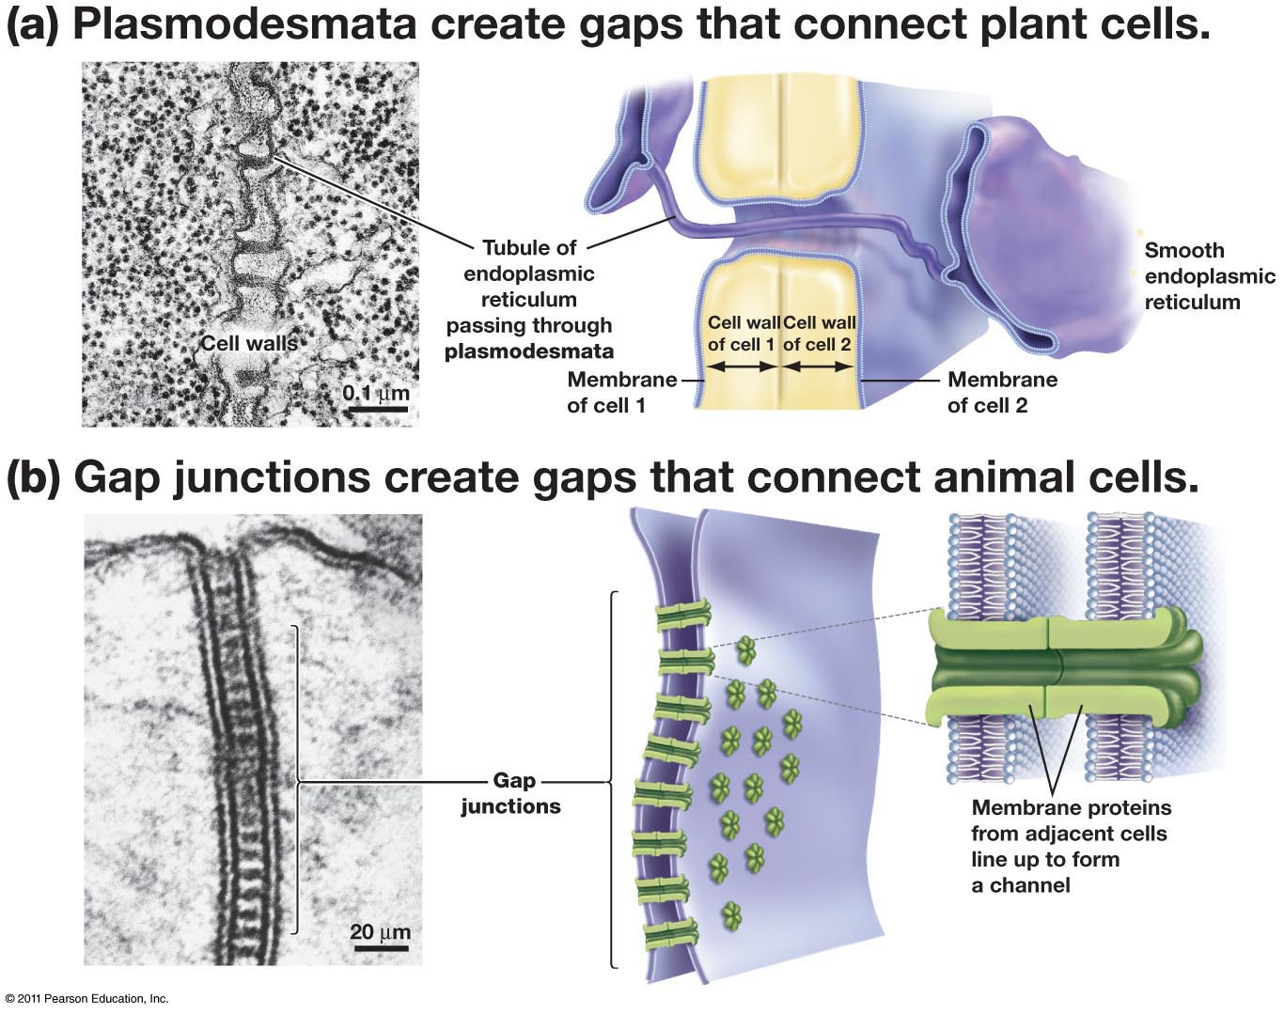

Slide 5
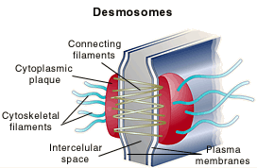
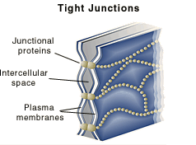
Desmosomes hold adjacent cells together
Tight junctions prevent solutes from moving between adjacent cells

Slide 6
Hormones: cell-cell communication between distant cells
Common features of hormones:
Secreted
Act on distant cells
Small amounts; large effects
Characteristic responses (tissue/cell-type specific)
Feedback loops
Common functions of hormones:
Regulate homeostasis, development, reproduction, stress response
Mediate changes in transcription
Mediate changes in protein activity
Coordinate activities of multiple cells
Four (Five) general steps:
Signal reception
(Signal transduction)
Signal amplification
Signal response
Signal deactivation
Nuances:
Tissue/cell-type specific responses
Signal crosstalk

Slide 7
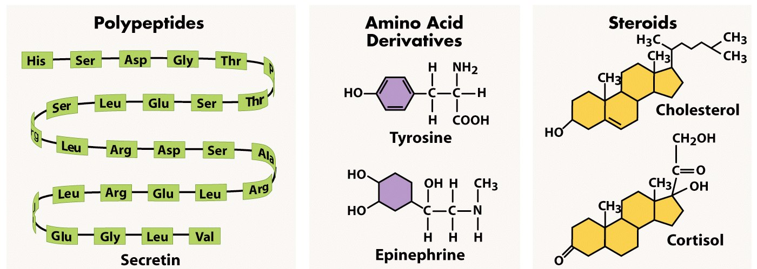
Hormone Structures
Freeman 4e 47.3
Notes:
7
The key difference in these hormone types is that steroids are lipid soluble but polypeptides and amino acid derivatives are not. Thus, steroids cross cell membranes much more readily than do other types of hormones.
Some hormones are lipid soluble and others are not. Differences in lipid solubility influence where a target cell receives the chemical message. Steroids often act inside the cell, whereas most amino acid derivatives and all polypeptides act at the cell surface.
Steroid hormone-receptor complexes bind to specific sites in DNA called hormone-response elements. Gene expression begins when a regulatory protein such as a steroid hormone-receptor complex binds to the hormone-response element for that gene.
Because epinephrine and the peptide hormones are not lipid soluble and cannot enter the target cell, they must bind to receptors on the cell surface. The process of activating a receptor on the cell surface is called signal transduction.

Slide 8
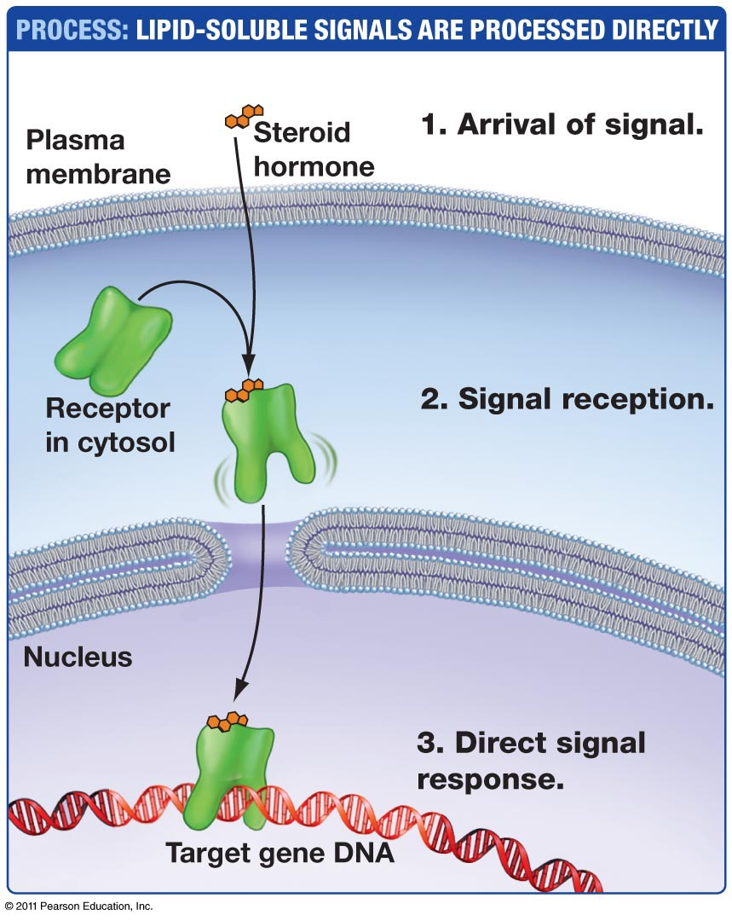
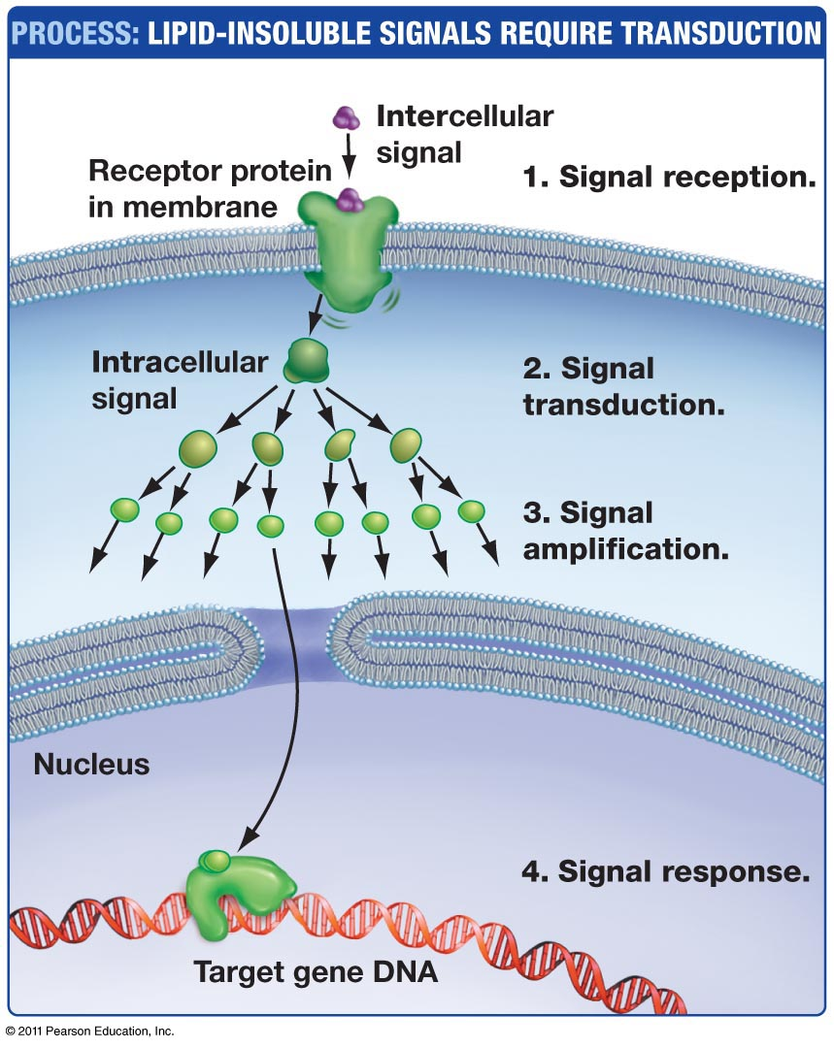
Signal transduction pathways

Slide 9
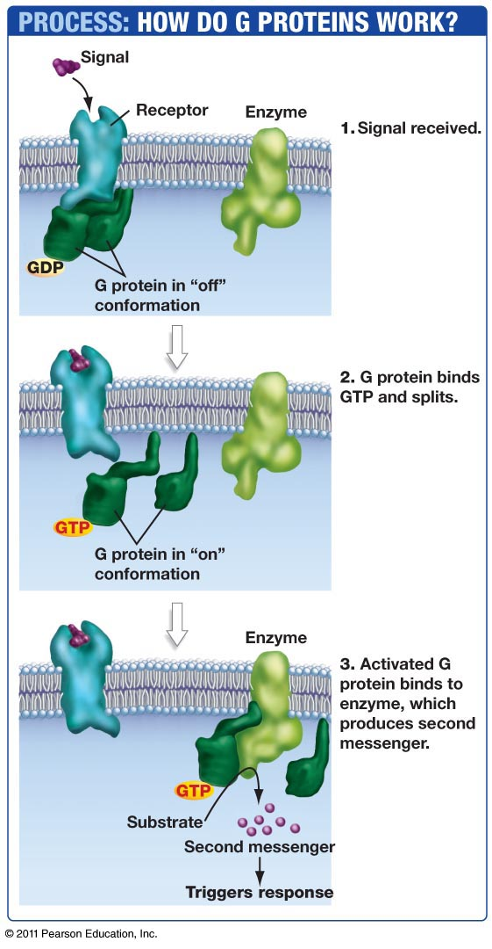
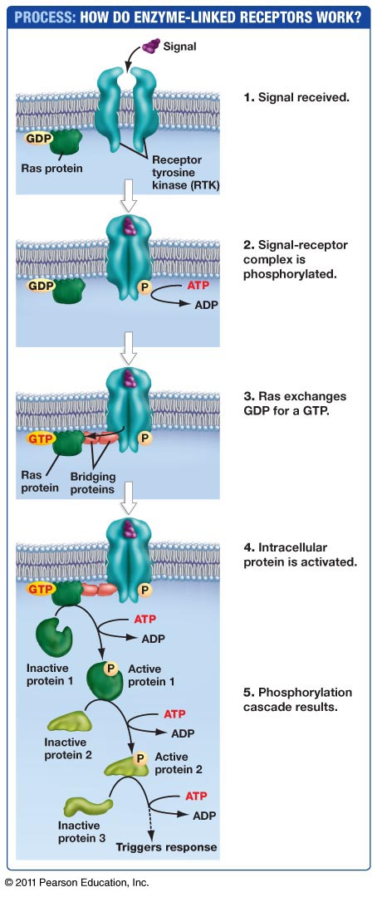

Slide 10
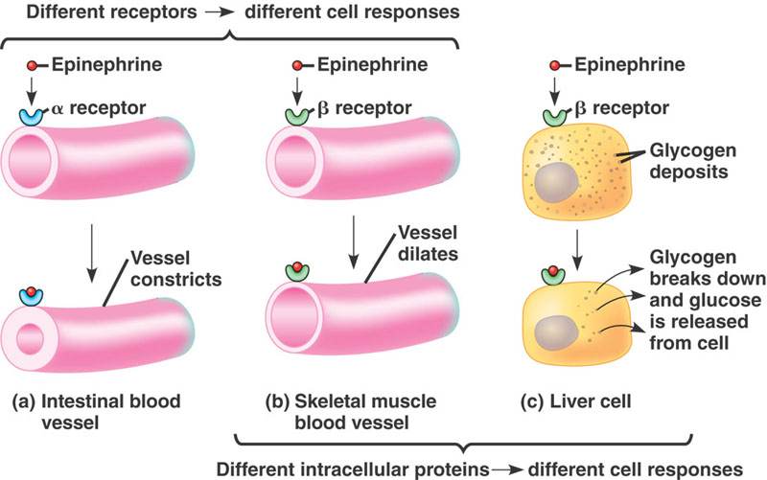
Hormonal effects are tissue-specific
Fig 45.8 Campbell & Reece
Notes:
10
Epinephrine activates phosphorylase, the enzyme that catalyzes the formation of glucose from glycogen
Epinephrine produces two distinct patterns of responses because there are two types of receptor, alpha and beta. In turn, there are two types of alpha and two types of beta receptor.
The same hormone may have different effects on target cells that have
Different receptors for the hormone
Different signal transduction pathways
Different proteins for carrying out the response

Slide 11
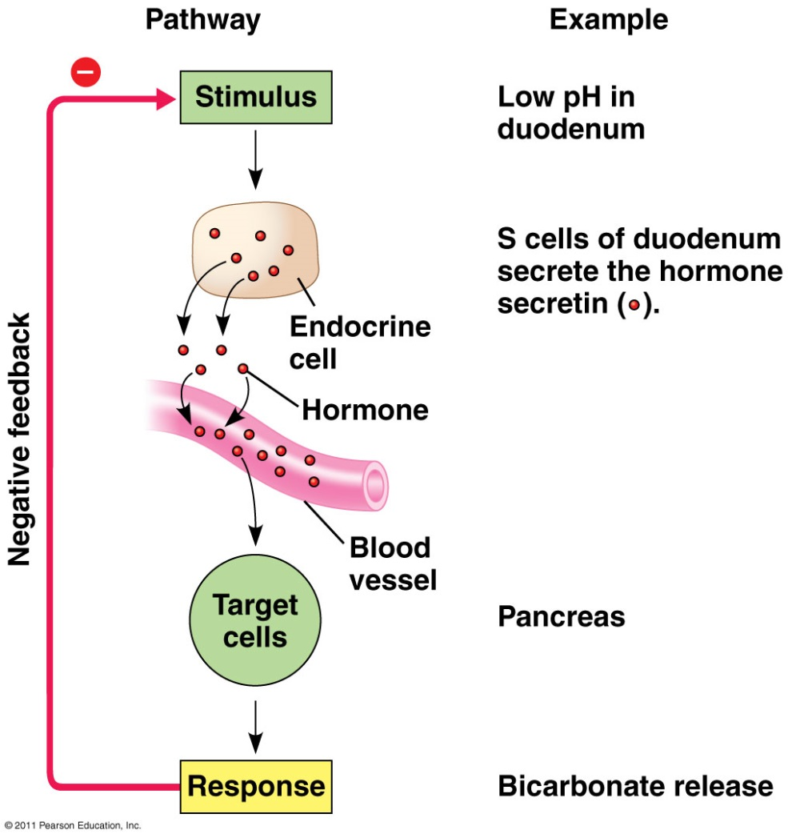
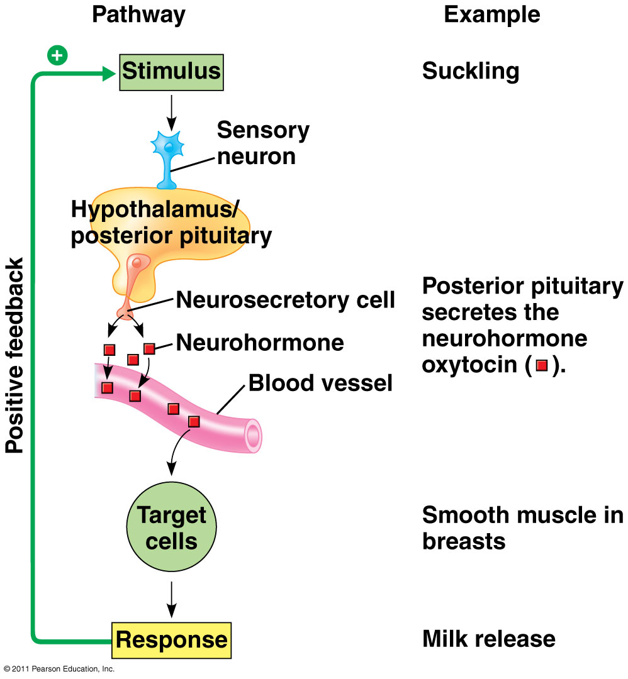
Negative vs Positive feedback loops
Campbell 8e 45.11
Notes:
Negative feedback loop: the response reduces the initial stimulus, which then lowers the response and returns conditions to ‘normal’ setpoint to maintain homeostasis
Positive feedback loop: the response reinforces or enhances the stimulus, leading to an even greater response

Slide 12
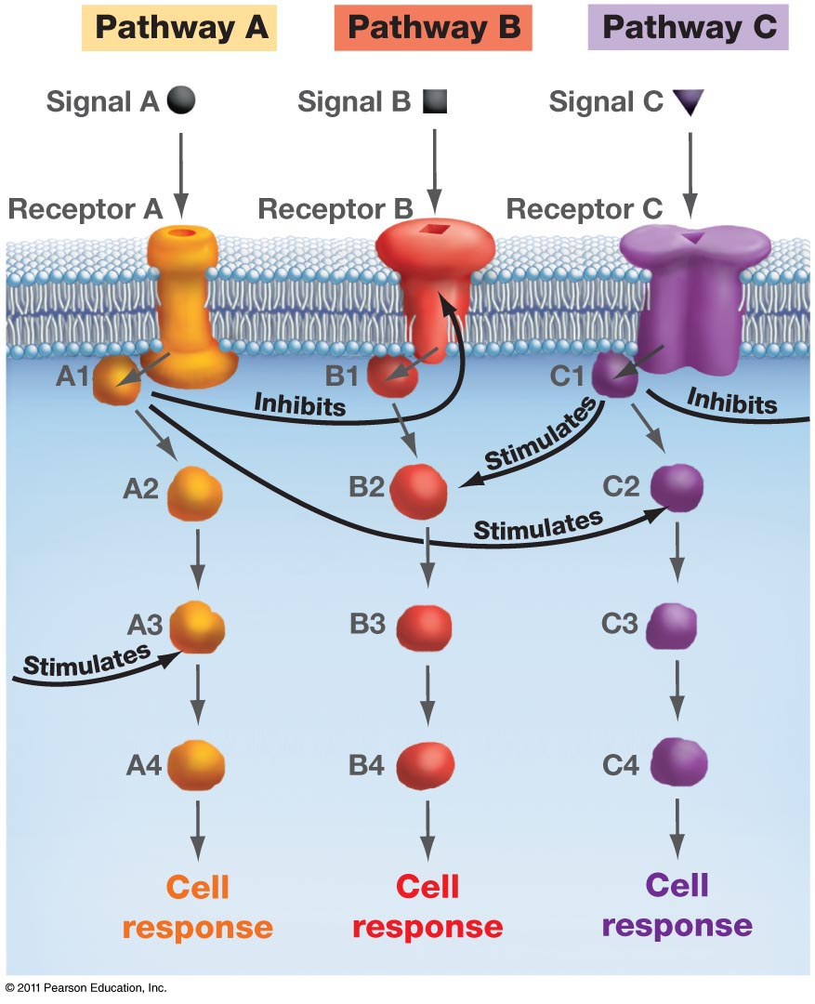
CROSSTALK
When one or more components of a signal transduction pathway affects another pathway.
What is the response when a cell receives signals A and B at the same time?

Slide 13
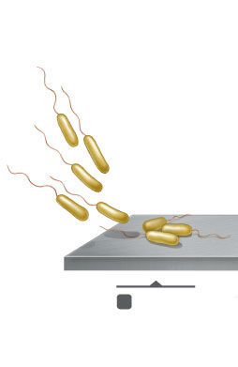

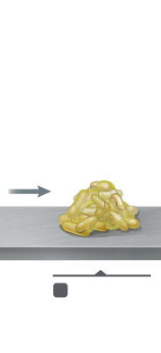
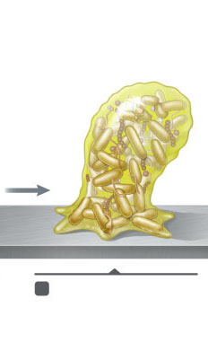
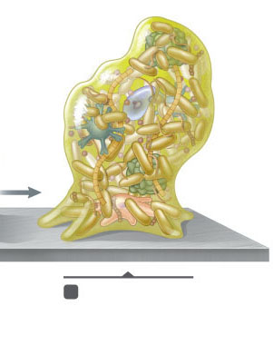
Biofilm formation
Complex aggregation of prokaryotes attached to a surface, forming a community
Consider how individuals sticking together could lead to multicellularity
Prokaryotes can sense their density & respond (quorum sensing)
1. Reversible
attachment of
bacteria (sec)
2. Irreversible
attachment of
bacteria (sec–min)
3. Growth and division of bacteria
(hr–days)
4. Production of extracellular
polymer substances, leading to biofilm formation (hr–days)
5. Attachment of other organisms to biofilm (days–months)

Slide 14
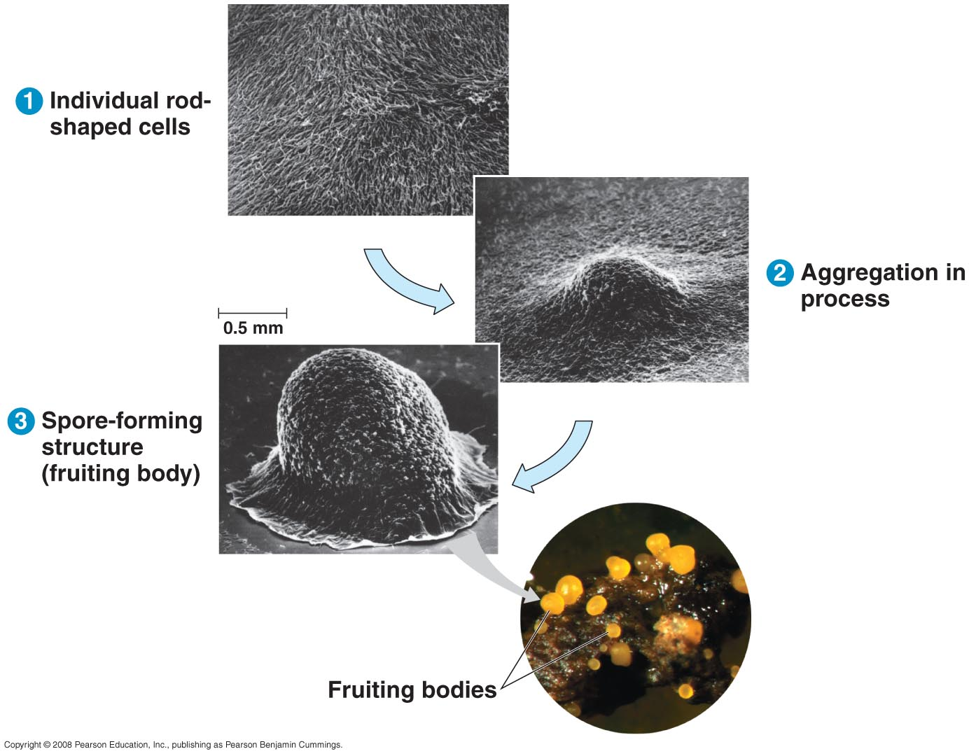
Communication in Myxobacteria
Campbell & Reece, Fig. 11.03
Notes:
Live in single cell biofilm = swarm → aids in predatory feeding
Environmental cue → fruiting body
14

Slide 15
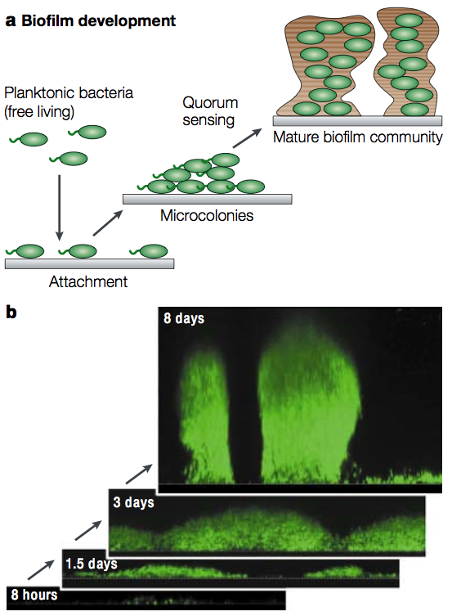
Pseudomonas aeruginosa
Fig. 2 in Fuqua, C & EP Greenberg. 2002. Nature Rev Mol Cell Biol, 3: 685-695
Notes:
15

Slide 16
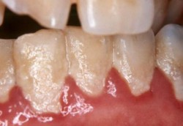
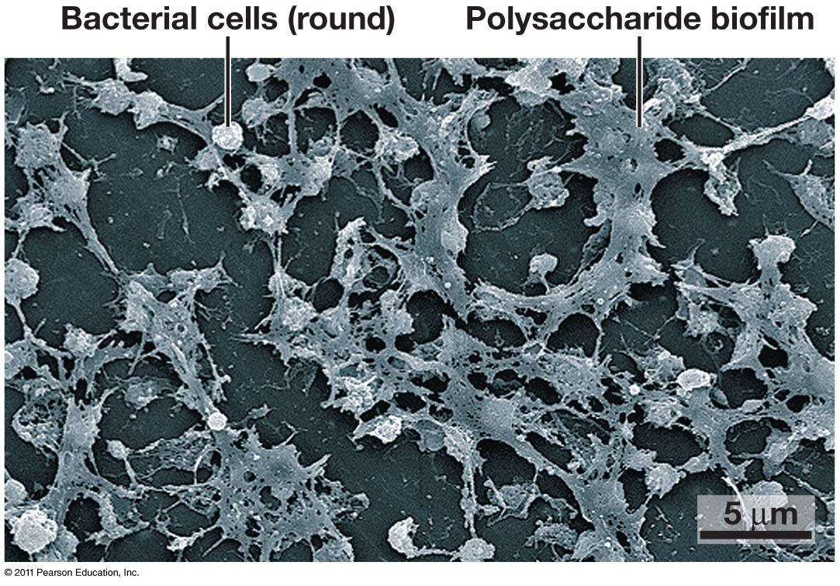
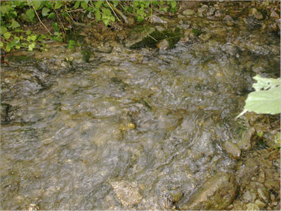
http://textbookofbacteriology.net/normalflora_2.html, http://www.geomicrobiology.de/research/biofilms/biofilms.html, http://meadfamilydental.com/2011/11/plaque-vs-biofilm-and-the-research-that-could-change-dentistry-as-we-know-it/
Notes:
Biofilm in a fast moving stream

Slide 17
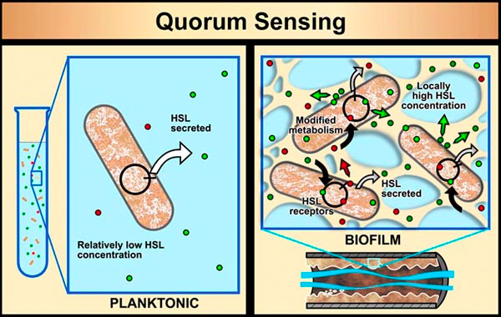
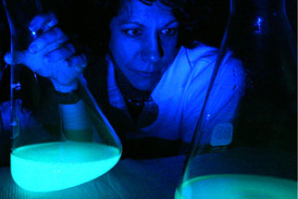
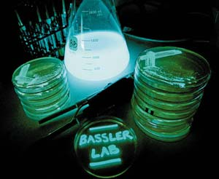
HSL = homoserine lactones
Notes:
Though planktonic cells secrete chemical signals (HSLs, for homoserine lactones), the low concentration of signal molecules does not change genetic expression. Biofilm cells are held together in dense populations, so the secreted HSLs attain higher concentrations. HSL molecules then re-cross the cell membranes and trigger changes in genetic activity.
http://www.youtube.com/watch?v=YJWKWYQfSi0&feature=related
Mcfall ngai http://www.youtube.com/watch?v=x5-VcJyZRc4&feature=related

Slide 18
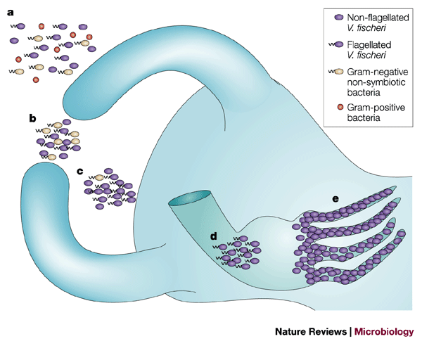
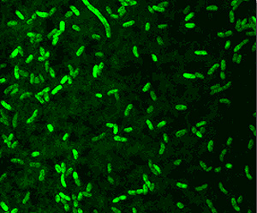
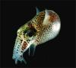
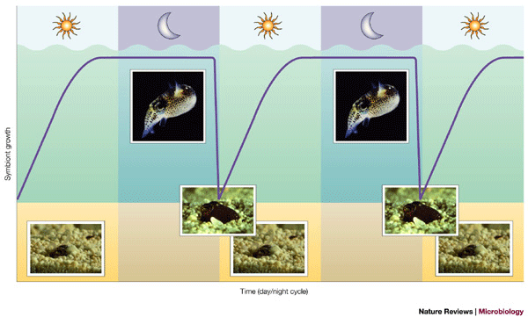
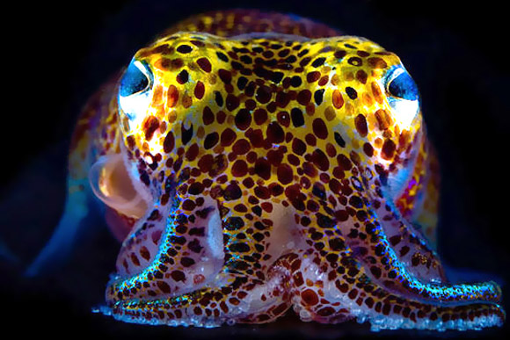
http://serc.carleton.edu/microbelife/topics/marinesymbiosis/squid-vibrio/index.html, http://www.ecosystm.org/squid_glowing_bacteria_work_well_together.htm, Nyholm and McFall-Ngai 2004
Notes:
The winnowing
V. fischeri, Euprymna scolopes

